Slide 1
Data analysis for customer satisfaction

Slide 2
DATA ANALYSIS FOR CUSTOMER SATISFACTION
1
Schneider Presentation - SEE
2
Customer Satisfaction in SEE
3
Data Analytics CS Project

Slide 3
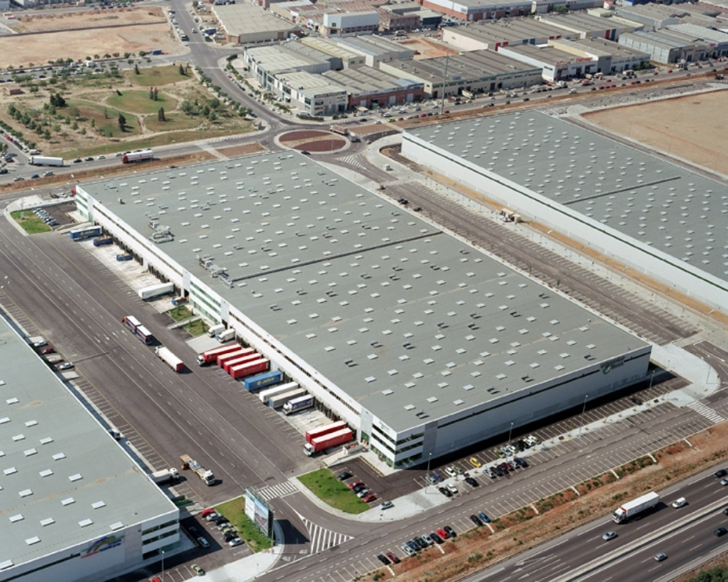
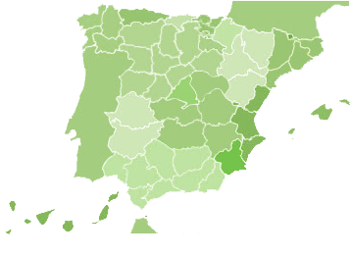
SCHNEIDER ELECTRIC
PRESENCIA LOCAL
the global specialist in energy management and automation
España es nuestra puerta logística para Europa, Oriente medio y Suramérica
Balanced geographies – FY 2015 revenues¹
15 commercial delegators
€27 billion FY 2015 revenues
~5%
of revenues devoted to R&D
~160,000
people in 100+ countries
4.000 personas
27%
North America
26%
Western Europe
Logistic center
6 plantas
29%
Asia Pacific
6 industrial Sites
Diversified end markets – FY 2015 revenues¹
18%
Rest of World
+100M€ invertid
6 Execution Centers
Non-residential &
Residential Buildings
Data Centers & Networks
Industrial
& Machines
Utilities & Infrastructure
45%
14%
21%
20%

Slide 4
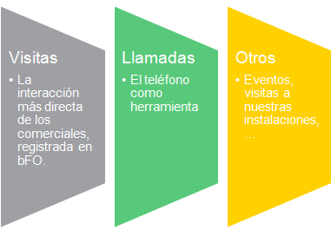
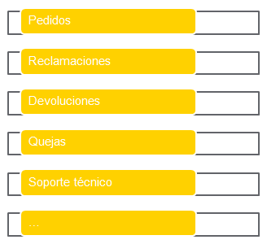
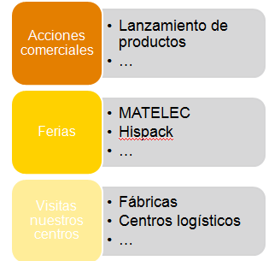
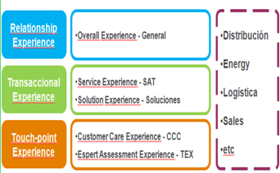
For each interaction we listen THE VOICE OF CUSTOMERS
CUSTOMER
COMMERCE
CUSTOMER SATISFACTION
SURVEYS
COMMERCE
EVENTS
CCC
SPECIFIC MEETINGS
CCC
EVENTS
SPECIFIC MEETINGS
CUSTOMER SATISFACTION
SURVEYS

Slide 5
Project Objective
Process Analysis
Modelling
To find out the Key Drivers which impact in
Customer Experience, influencing on the evolvement of our Business
Through Statistical Methodology for analyzing patterns among different Factors and attributes from our Data Bases….
Modeling group influencing factors impacting together Customer Satisfaction
Root Cause of different score ranges for Recommendation (NPS)
Best relation between different variables and main influencing factors which guide our Business on Effective Action Plans which Impact fully on increasing the Satisfaction of our Customers

Slide 6
ARE YOU READY FOR THIS CHALLENGE?
JOIN US

Slide 8
Questions?

Slide 9
THANK YOU.

