Slide 1
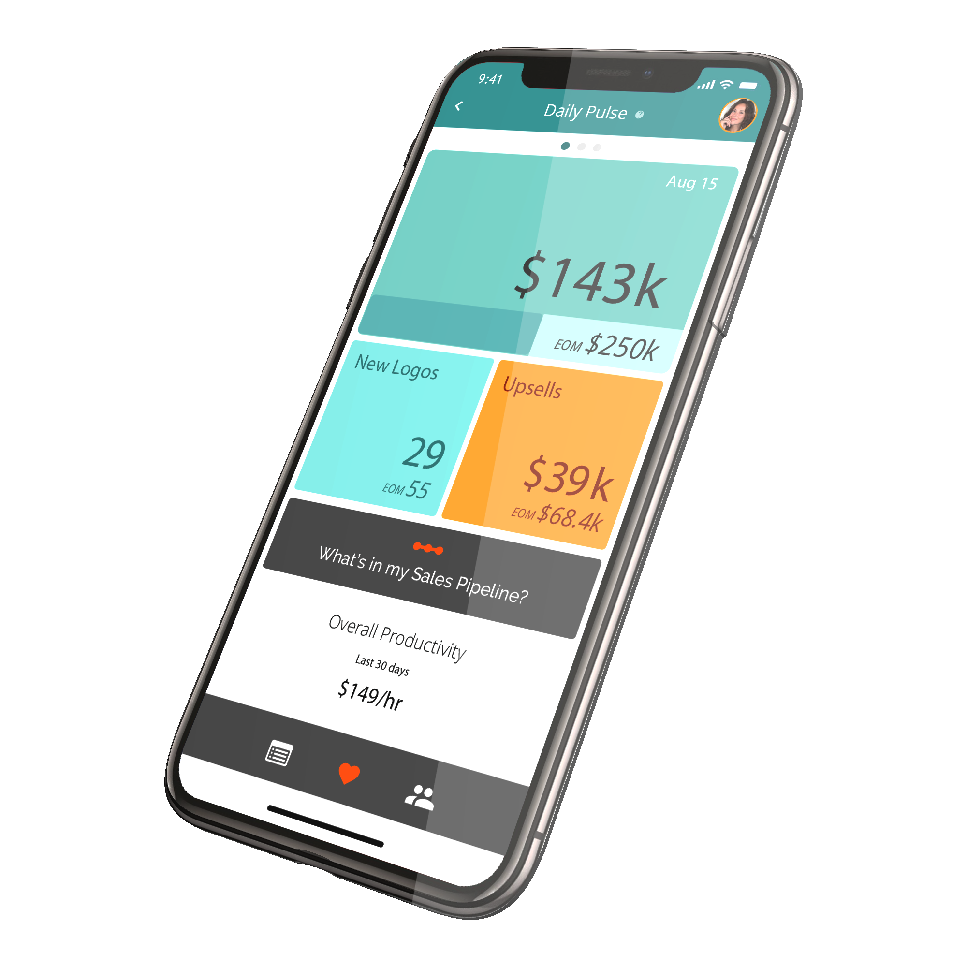
Data Science & Data Engineering Internship Program
Cien is Artificial Intelligence
for Higher Sales Productivity
Rob Kall, Cien Inc,
carreers@cien.ai www.cien.ai US: +1 305-203-1288 EU: +34 935-111-349
© Cien, Inc. 2018 - Proprietary and Confidential.

Slide 2
Cien is an AI-First Company
© Cien, Inc. 2018 - Proprietary and Confidential.
Notes:
if the answer is yes to any of these, please contact Cien customer success

Slide 4
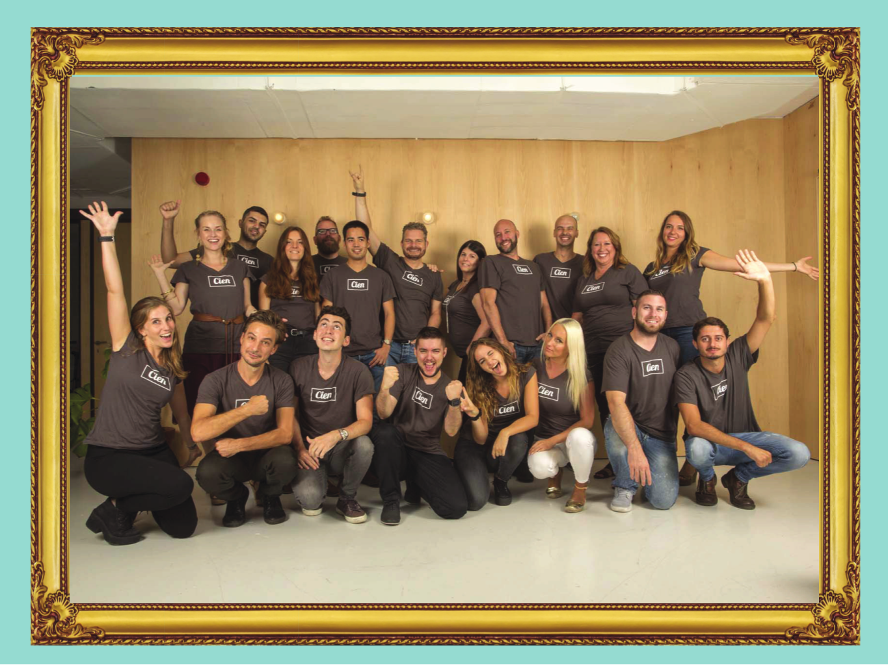
Culture Matters

Slide 5
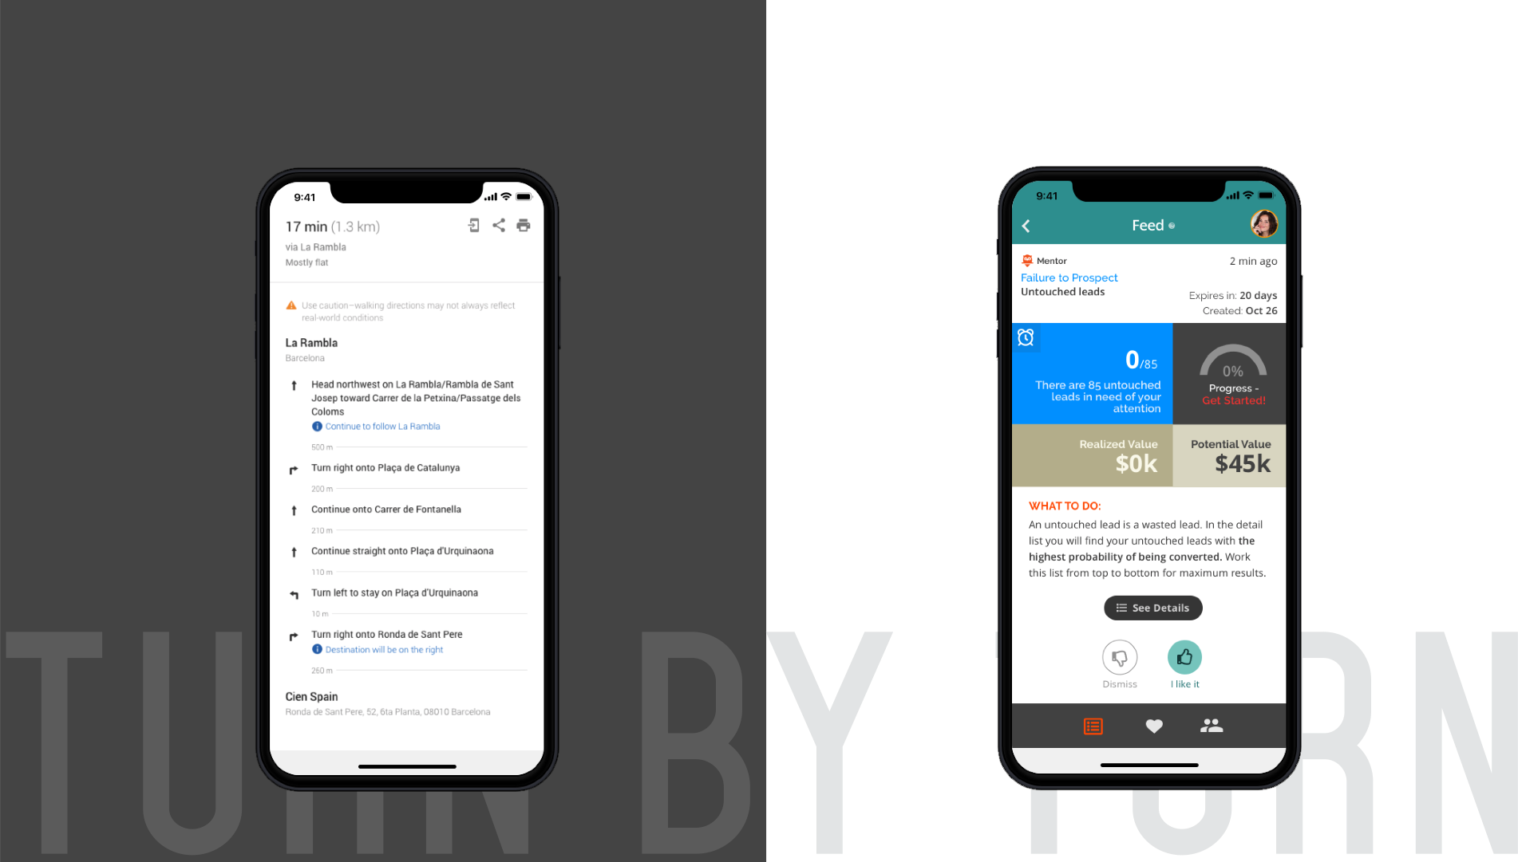
Prescriptive Analytics for Sales Teams
Google Maps
Cien

Slide 6
Big Datasets

Slide 7
Tools

Slide 8
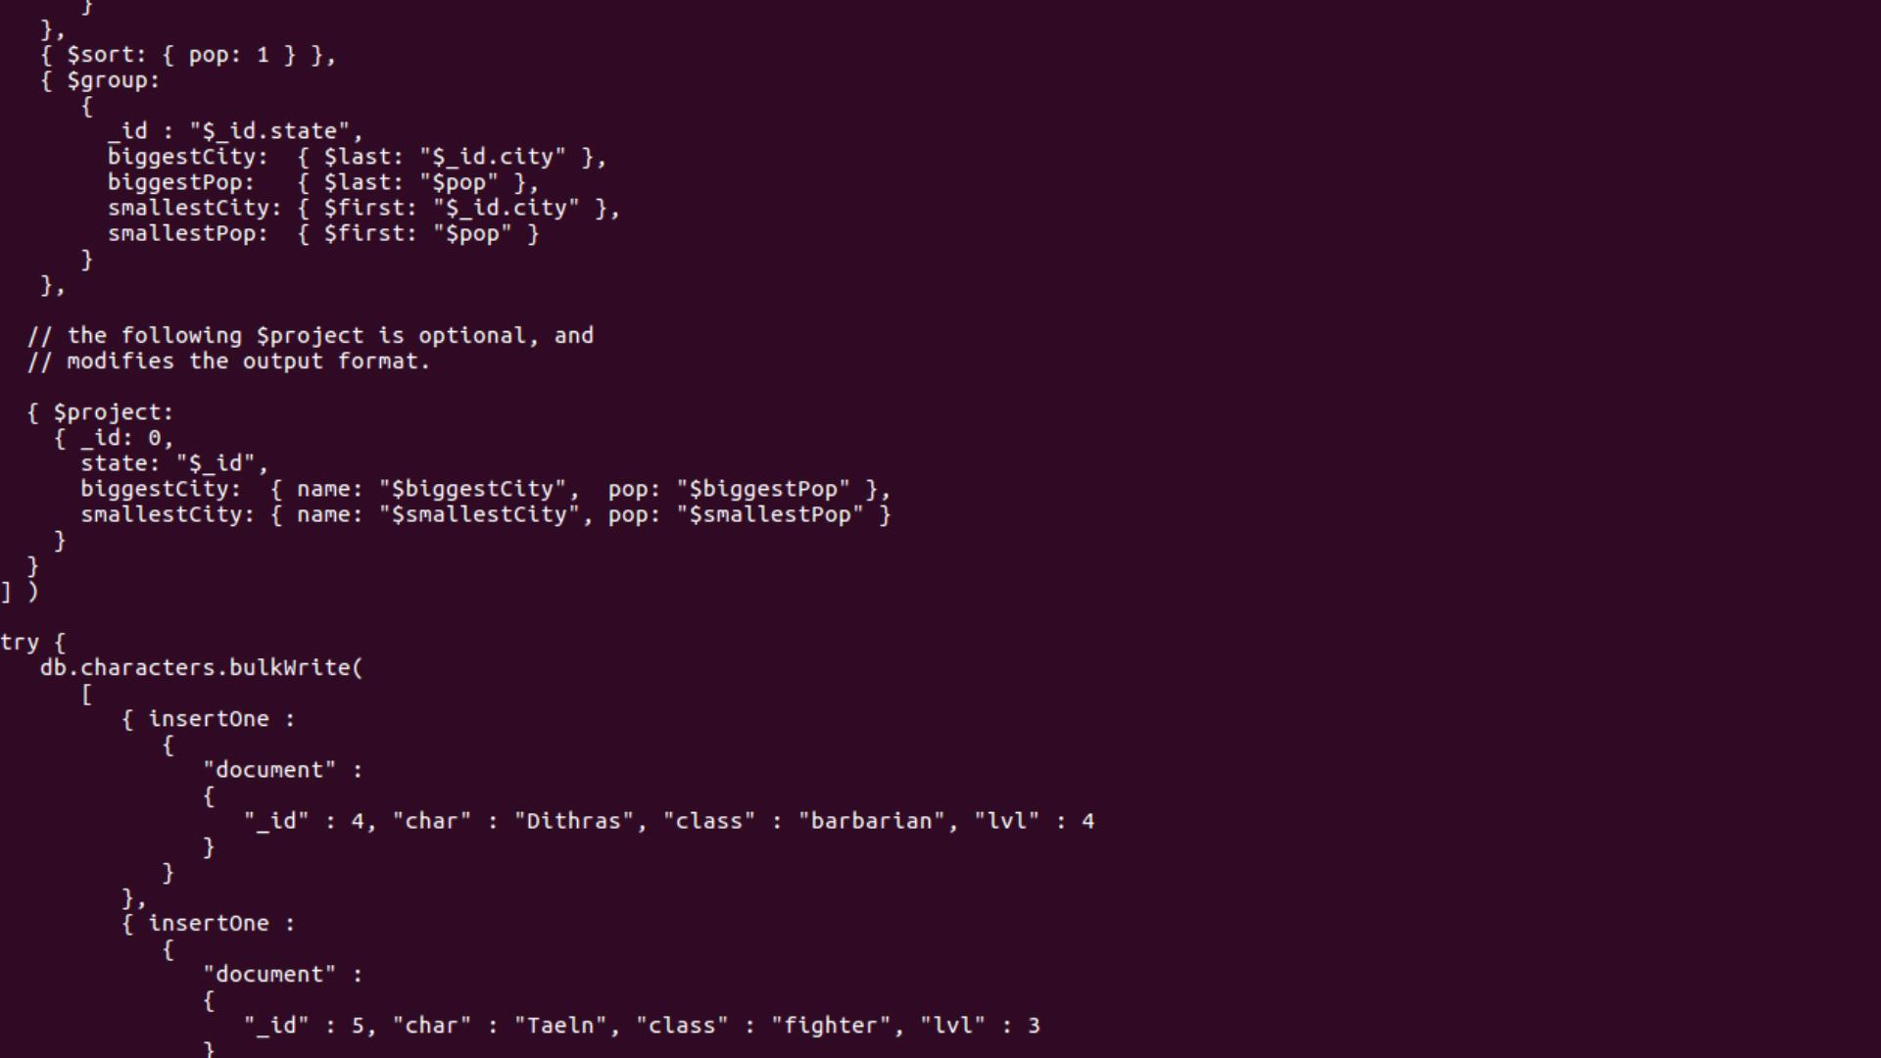
Coding & Production

Slide 9
Internship Program
DS/DE Internship Roles
Structured Onboarding/Training
Work on production models
Many different types of problems
Very accomplished co-workers
Paid!
www.cien.com/careers

