Slide 1


Slide 2




WHAT WE DO
We continuously develop advanced productivity tools for users, universities and the global scientific community.
We are a software development company founded 20 years ago. Our headquarter is in Barcelona and we also have offices in the USA. We’ve been named as “The Makers of MathType”, revolutionizing the educational field with innovative methods.
Now, we are improving the STEM subjects with our innovative products.

Slide 3















OUR PRODUCTS
More than 11.000.000 subscribers
More than 2.000 daily trials
Global providers:
Helps life scientists to prepare their experiments and communicate their results by providing technology for easy laboratory calculations, results analysis, visualization, and sharing.
Computer based grading of math and science questions. Random parameters and graphics in your STEM quizzes. Integrate with your own assessment engine with our public API. Integrated into Moodle.
Easily create math equations and chemistry formulas using a visual editor. Handwriting on mobile and tablets. Integrated into leading LMS and word processors.

Slide 4






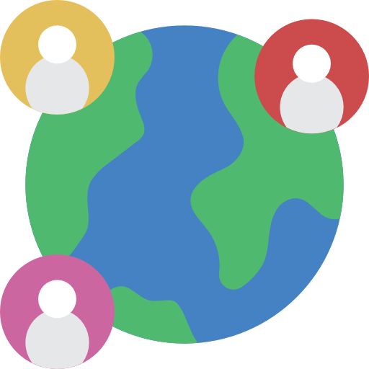

WIRIS IN ACTION
Healthy food habits (fruit, yoghurts, nuts)
4 types of milk
Different kind of teas and coffee
More than 70 employees
Offices in 2 countries
Multicultural environment
Employees from 12 different countries
Global market (NA, EU, LATAM & APAC)
136 countries use our product
Solutions for businesses, universities and users

Slide 5



GROW AT WIRIS
Regular feedback talks to enhance your development
Weekly and/or daily meetings with your team to distribute tasks
Internal trainings focused on hard and soft skills
Webinars and meet-ups
Our team dedication is the basis of our success.
Working hard and having fun are a sign that we are doing the right things in the right way.

Slide 6
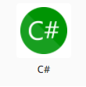
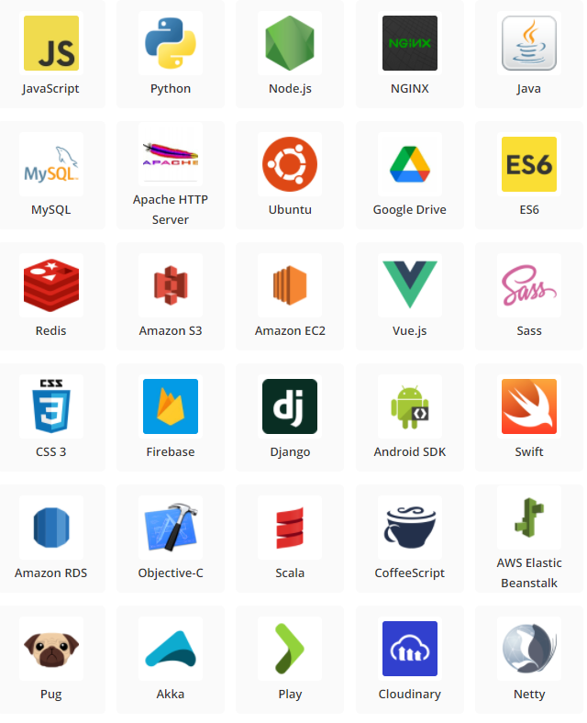

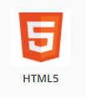

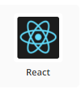


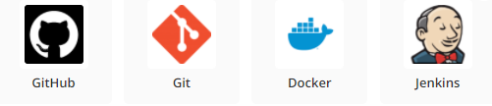

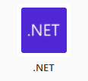
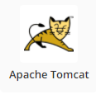




Some of our tech stacks

Slide 7
OUR VALUES
CONTRIBUTION
We want to leave our mark
Everything is possible, it is up to us to transform the opportunities that lie ahead of us into reality.
We set challenging goals and INNOVATE in every possible field in order to reach them and contribute to make people’s STEM work more meaningful.
COURAGE
We are brave and determined
In our world the rules and guidelines cannot always show us the way.
We are FREE to think out of the box and take actions on our own terms.
We are OPEN MINDED people with a fundamental guideline and rule: RESPECT each other.
LEADERSHIP
We have the aspiration to transform
Each of us is driven by goals and we assume full responsibility for our COMMITMENTS.
We create networks and build TEAMS to perform and deliver value. Straightforward and open communication based on TRUST is the key for fruitful relations.

Slide 8









WIRIS SOCIAL MEDIA
@wiris_science @MathType
@mathtype_by_wiris
WIRIS
WIRIS math & science
wirismath
MathType
CHECK OUT OUR LATEST NEWS AND STAY TUNED BECAUSE
#WEAREGROWING

Slide 9
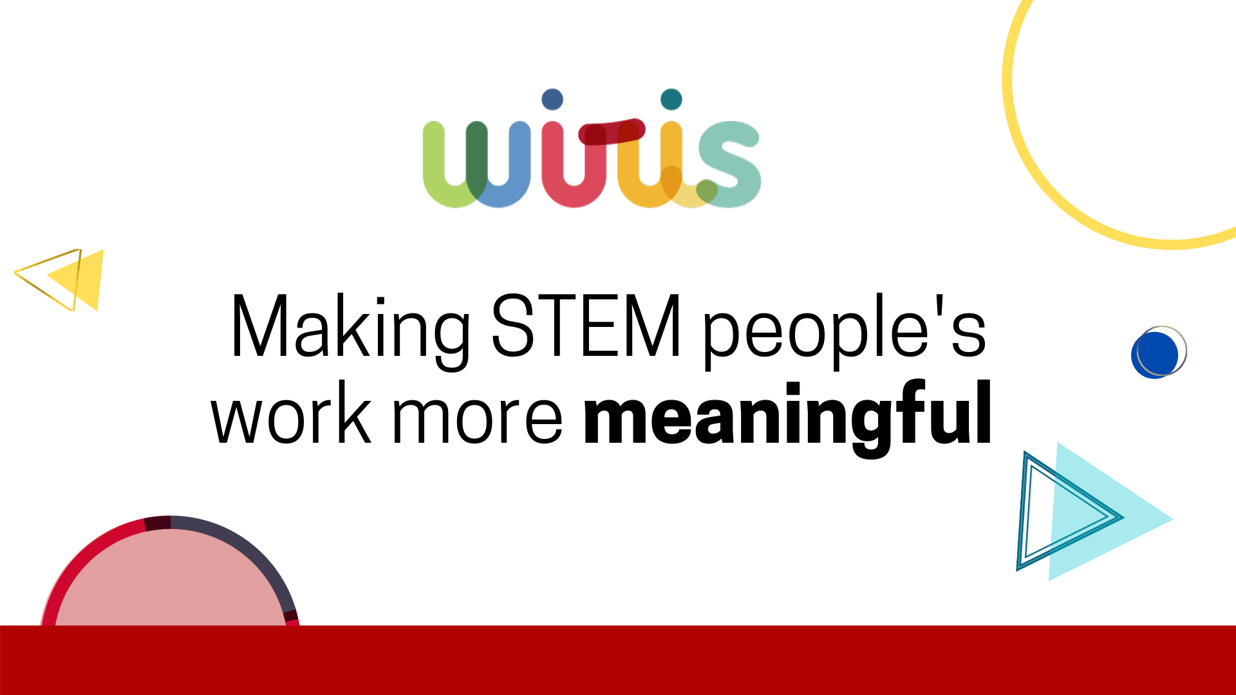
www.wiris.com

